Slide 1
Cosmic Twin
Our Harmony between the Exploration of exoplanets and the Innovation of ExoVibe creates a Cosmic Twin.

Slide 2
Chronicles of Exoplanets Exploration
The challenge we face is making the discovery of exoplanets accessible and engaging to students of all backgrounds. While the study of exoplanets offers incredible insights into the nature of planetary systems, traditional educational resources often fail to capture the imagination or reach underserved communities. Our goal is to bridge this gap by creating innovative, interactive tools that transform complex scientific concepts into exciting and accessible learning experiences.

Slide 3
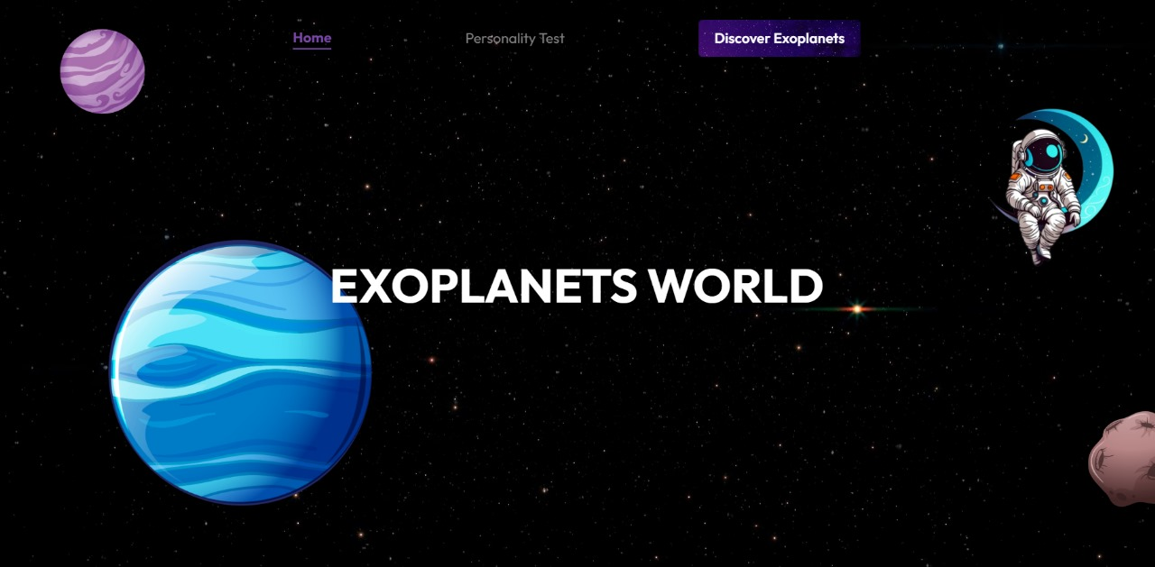
Main Page

Slide 4
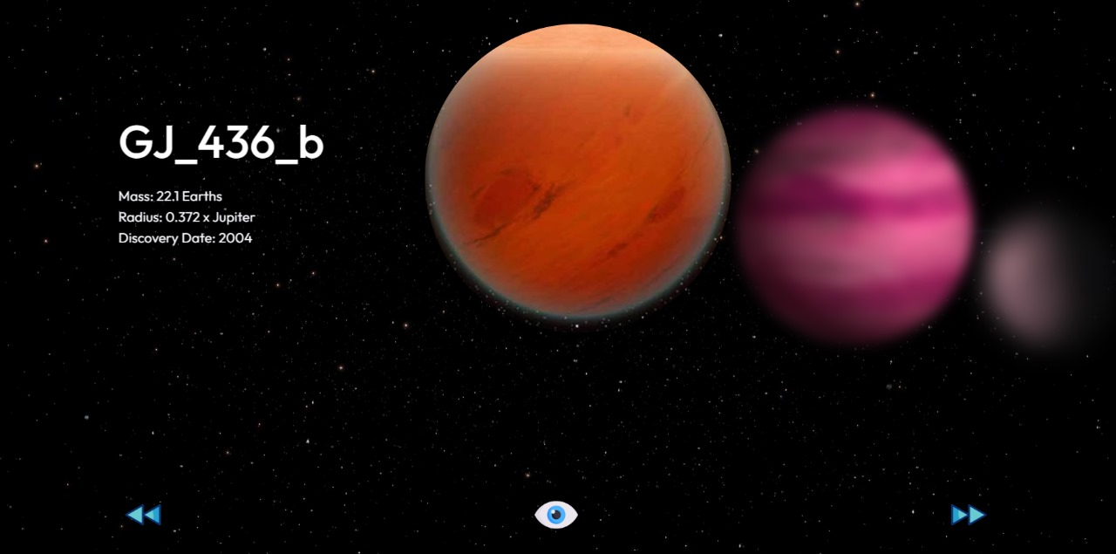
Slider

Slide 5
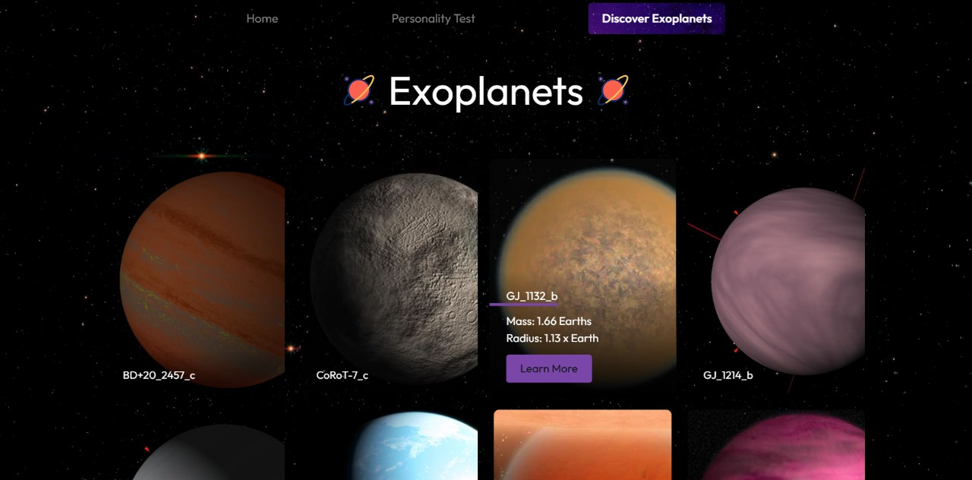
Accessible Exoplanets Materials

Slide 6
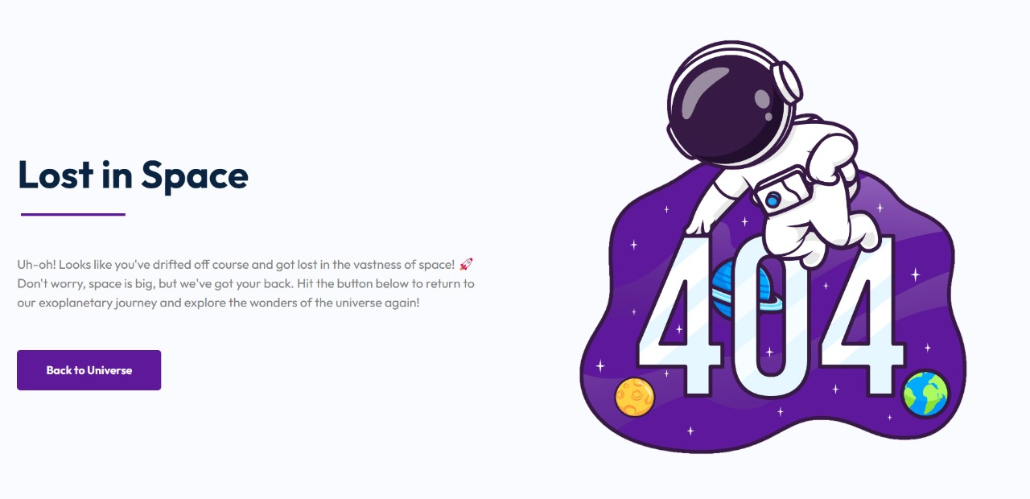
Not Found Page

Slide 7
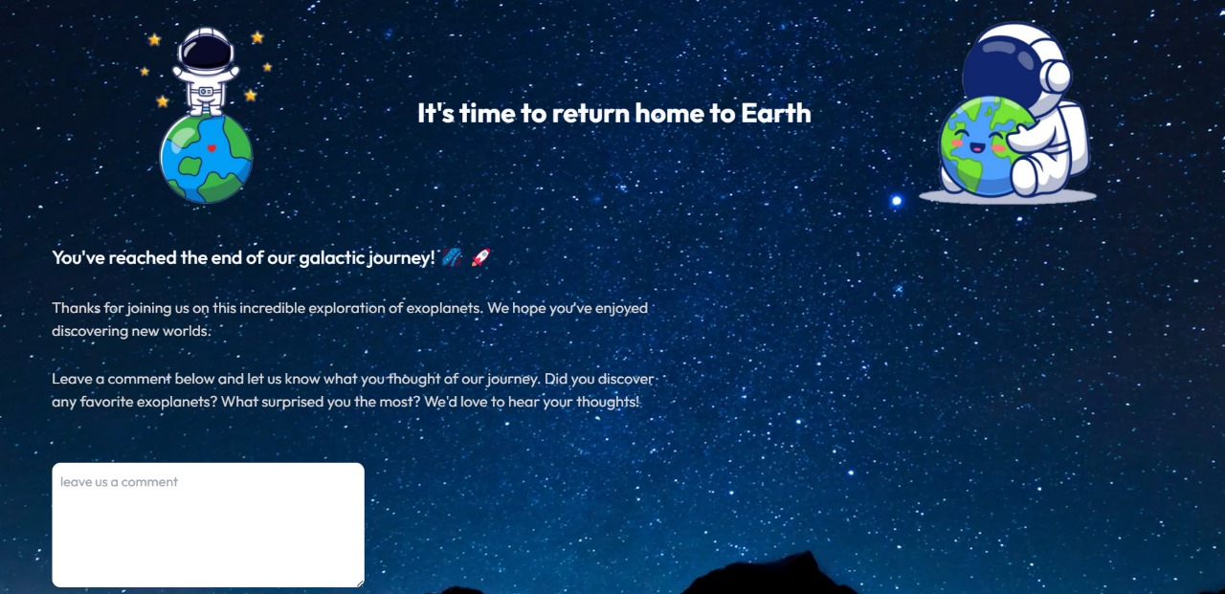
Journey Closing

Slide 8
THANKS

